Slide 1
Meeting 30

Slide 2
Agenda
A bug in amount model
Re-run the optimization
Run optimization with occurrence parameters only
Look into rainfall and runoff behaviors
Schedule of meeting

Slide 3

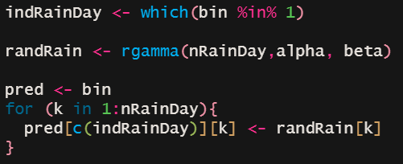
Amount model
Generate a binary series of rainfall occurrence for a month >> for each 1 in the binary generate 1 value from the gamma distribution
Generate a binary series of rainfall occurrence for a month >> generate a random series from the gamma distribution with length equals to all 1s in the binary series

Slide 4
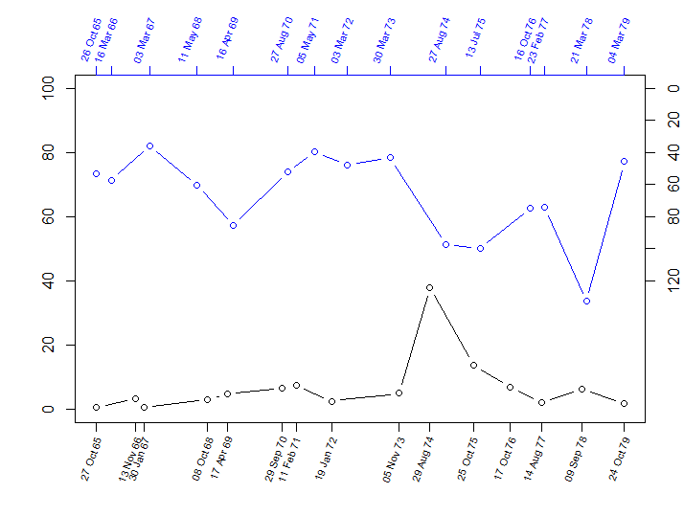
Annual Maxima Rainfall (1965-1979)
Runoff (mm)
Rain (mm)
Obs Rain
Vir.Obs. Runoff
Annual Maxima Runoff (1965-1979)

Slide 5
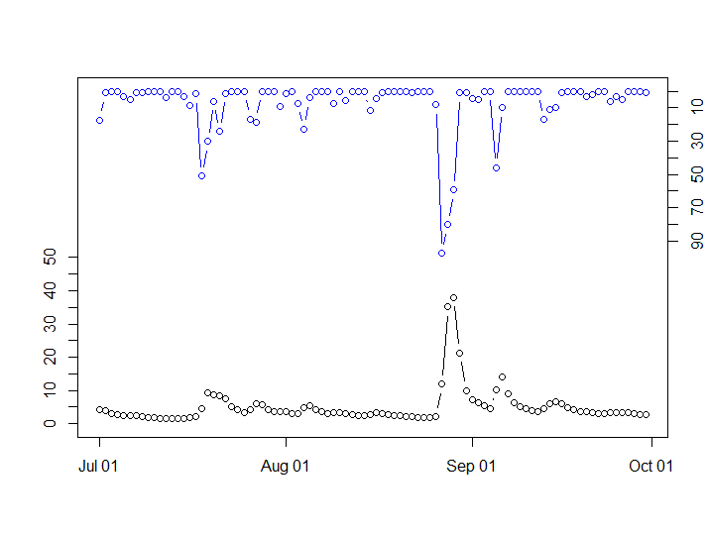
Daily Rainfall (01 July 1974 – 30 Sep 1974)
Obs Rain
Runoff (mm)
Vir.Obs Runoff
Rain (mm)
Daily Virtual Observed Runoff (01 July 1974 – 30 Sep 1974)

Slide 6
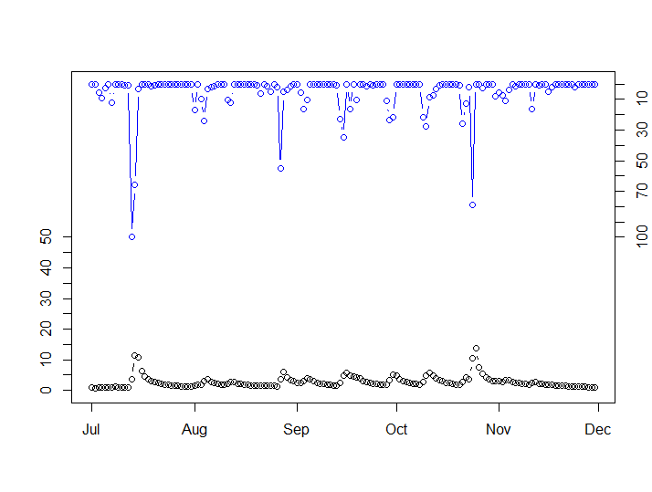
Daily Rainfall (01 July 1975 – 30 Nov 1975)
Runoff (mm)
Rain (mm)
Obs Rain
Vir.Obs. Runoff
Daily Virtual Observed Runoff (01 July 1974 – 30 Sep 1974)

Slide 7
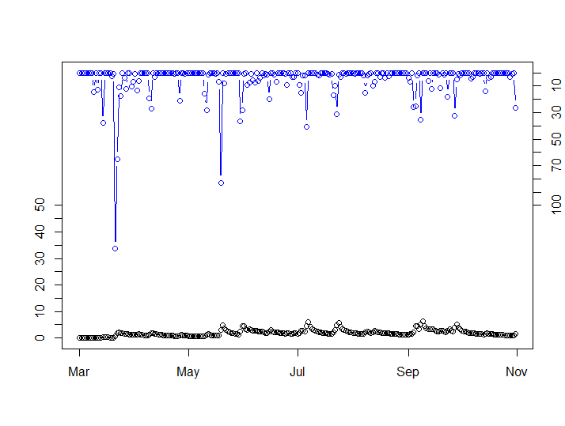
Daily Rainfall (01 Mar 1978 – 31 Oct 1978)
Runoff (mm)
Rain (mm)
Obs Rain
Vir.Obs. Runoff
Daily Virtual Observed Runoff (01 July 1974 – 30 Sep 1974)

Slide 8
Plan
Rerun the optimisation
Make a general skeleton for presenting the pilot study:
- motivation: presenting a case where “good” modelled rainfall translate to “bad” runoff.
- presenting: the WGEN model, the GR4J model, virtual observed streamflow, hydrological calibration procedure
- outcome of the calibration
- discussing on the use of the objective function

Slide 9
Meeting break
24 Dec 2021
31 Dec 2021
07 Jan 2022

